Slide 1
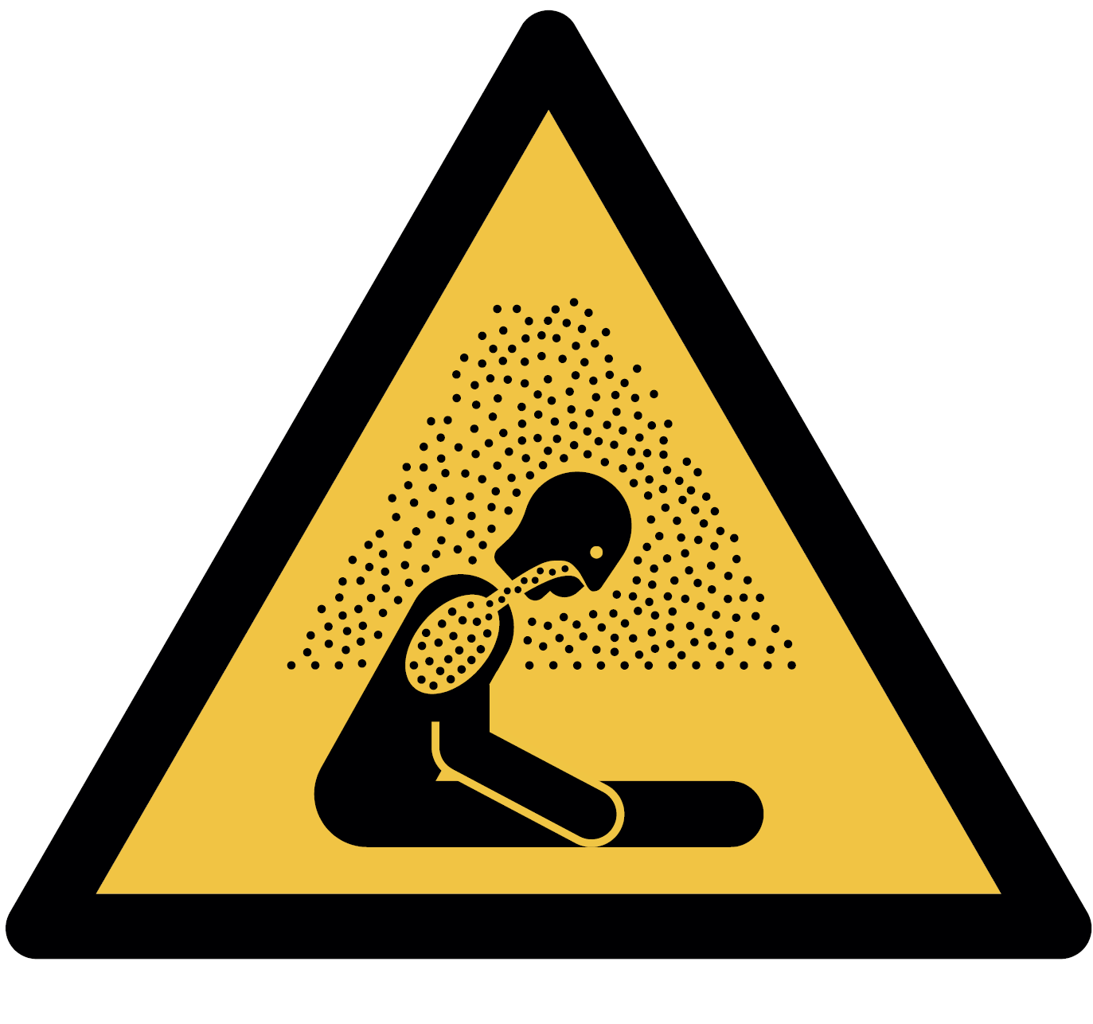


Warning;
liquid nitrogen.
Risk of asphyxiating atmosphere if spilled
Keep door open when room is occupied
Take a buddy for high risk work

Slide 2



Room 1.01 - Cryogenic storage and liquid nitrogen source
Hazards and emergency equipment
Warning; liquid nitrogen. Extremely low temperature.
Risk of severe cold burns
Warning; liquid nitrogen. Spills can deplete air of oxygen. Risk of asphyxiating atmosphere
Oxygen depletion alarm
Vacate room if alarm sounds and inform facilities team (6)12345
Emergency Andy Man (6)12346; Room 1.23
contact Facilities team (6)12345; Room 4.56

