Slide 1


I have been appointed BSO
What do I do?
George Giotopoulos
Annual BSO event
Tuesday, 18th of May 2021

Slide 2
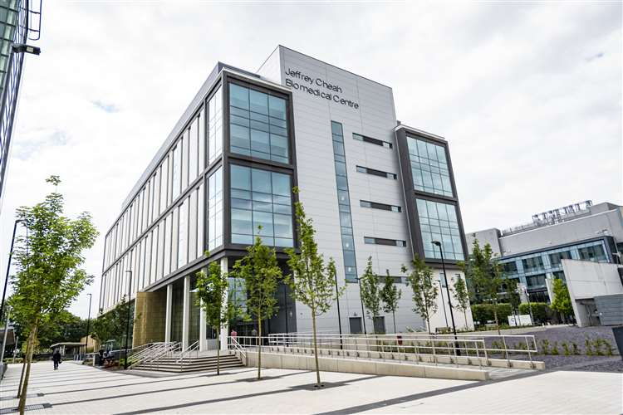
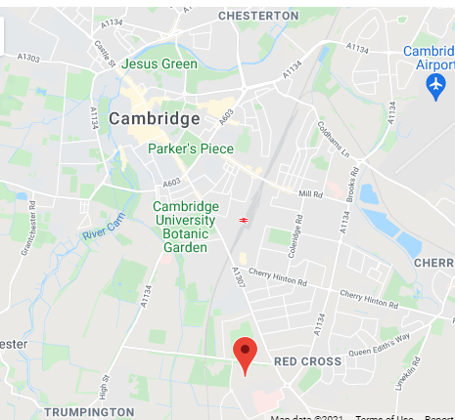
Who are we?
“The Cambridge Stem Cell Institute
is a world-leading centre
for stem cell research.
Our mission is to transform
human health
through a deep understanding
of stem cell biology”.
Wellcome – MRC Cambridge Stem Cell Institute

Slide 3
What do we do?
“Our scientists study stem cell behaviour,
both normal and pathological,
and use their findings to improve
the prevention,
diagnosis and treatment of diseases.
The research groups
work across three key research themes:
Stem Cell States,
Stem Cells in Disease and
Stem Cells & Therapeutics”.
Wellcome – MRC Cambridge Stem Cell Institute

Slide 4
What do we do…in Safety Office terms?
“Our scientists study stem cell behaviour,
both normal and pathological,
and use their findings to improve
the prevention,
diagnosis and treatment of diseases.
The research groups
work across three key research themes:
Stem Cell States,
Stem Cells in Disease and
Stem Cells & Therapeutics”.
Low risk tissue culture (CL1):
human, murine,
frogs and fish
Bandwagon work:
COVID-19
GM work:
Bacteria, lenti- retro- adeno-viruses,
Mice, rats, frogs and fish.
Animal work: Mouse, rat, frogs and fish. PDXs and CDXs (murine systems)
Primary human tissue(s):
Haematopoietic, heart, lung…anything with stem cells in it.

Slide 5
Who am I?
PhD in Genetics.
16 years in the lab…and counting
Main focus: Mouse models of normal and malignant haematopoiesis.
Work(ed) with mouse and human cell lines (CL1 and CL2), mouse and human primary tissue (CL1 and CL2),
GM (including viral delivery systems, mouse models), radioactivity (including radioisotopes and sources of
ionising radiation) among others…

Slide 6
The challenges
Reasonably sized institute: 28 PIs, ~100 Post docs, ~80 students, ~60 Research assistants.
4 core facilities plus one that is regulated by different committee (flow cytometry).
Groups came from ~10 different locations…all with their own rules (or lack thereof).
Most of us hadn’t even seen the building.
Nobody likes risk assessments.

Slide 7
The ‘how’
The Biological Safety Committee:
An influential chair.
2 core facility managers.
2 experienced safety officers.
3 PIs.
An experienced deputy BSO who is also the DSO.
Personal interaction with each and every lab as well as a biological safety representative for each lab.
Templates for BRAs.
Standardised text for sections such as waste management.
Admin support (secretarial staff).

Slide 8
The now and the future
Online depository of biological risk assessments curated by each lab.
Institute-wide GM forms (e.g. GM rodents).
Working towards a 10-day turnaround of new submissions.
PDX and/or CDX institute-wide risk assessments.
Institute-wide HSE notification for GM work.

Slide 9
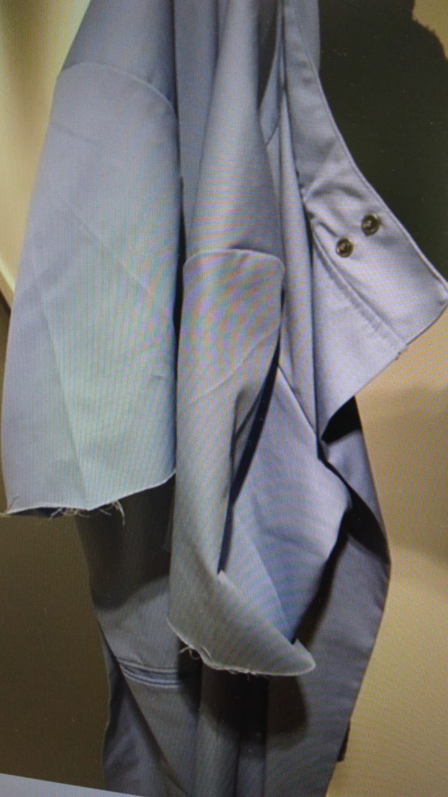
The rewards

Slide 10
Acknowledgements
Sally Lees
Sanjay Sinha
Mark Elsdon
Irina Pshenichnaya
Ingo Ringshausen
Joo-Hyeon Lee
Maria Alcolea
John Sinclair
Mark Wills
Androulla Gilliland
Special thanks to:
Steph Hall & Keff Tibbles

